Slide 1






2025 SPARK ACADEMY
TRAIN FOR CHANGE, FROM SCIENCE TO PRACTICE
THE SPRINT AI TRAINING FOR AFRICAN MEDICAL
Imaging Knowledge Translation (SPARK)
Academy
IN DEEP LEARNING & MEDICAL IMAGING
MedNext: Transformer-Inspired ConvNets
April 27th, 2025

Slide 2
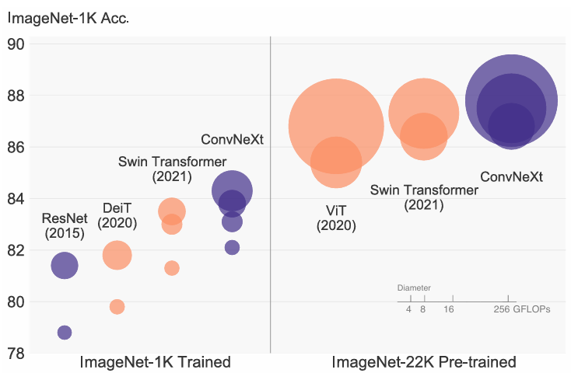
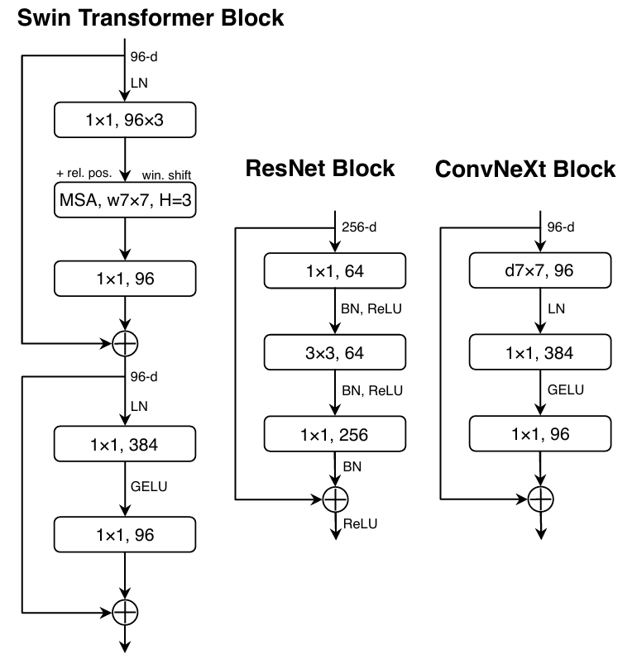
A Little ‘History’...
A ConvNet for the 2020’s
Introduced ConvNext
https://event.fourwaves.com/spark

Slide 3
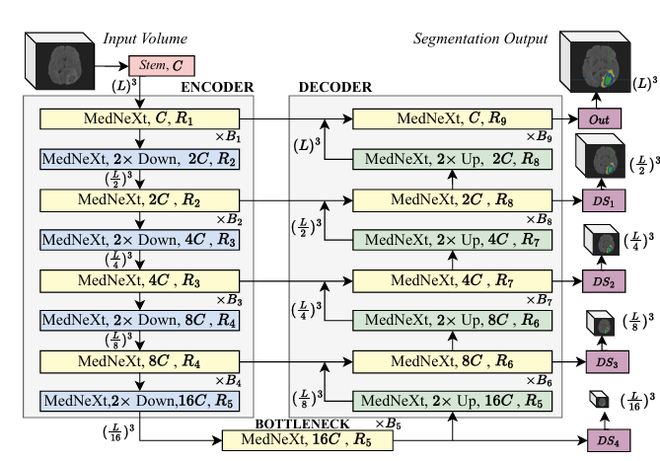
MedNext…
A fully ConvNeXt 3D Encoder-Decoder Network for medical image segmentation
https://event.fourwaves.com/spark

Slide 4
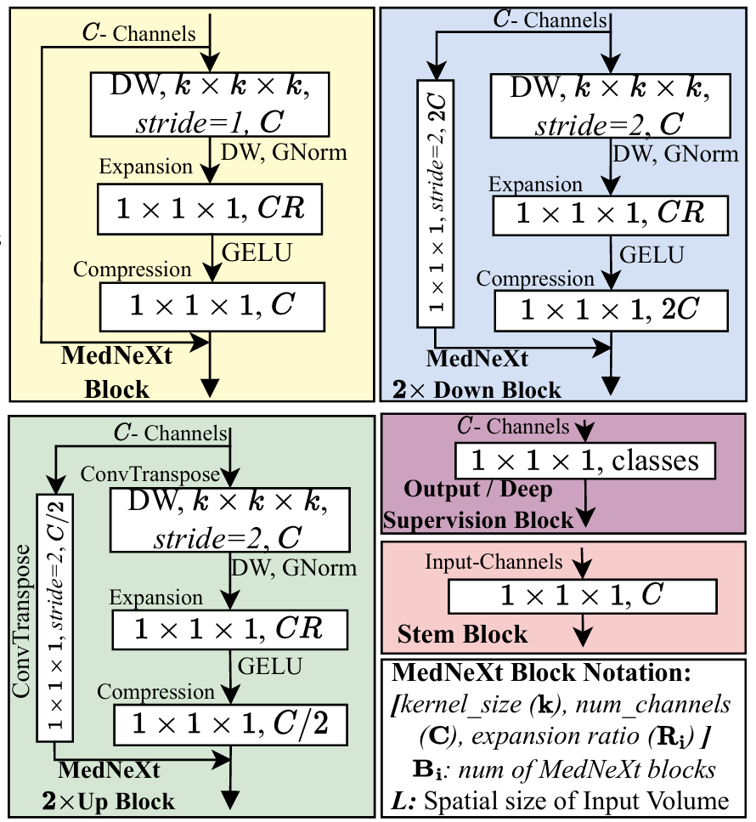



What’s Special about MedNext?...
Residual Inverted Bottlenecks:
For Upsampling and Downsampling
Depthwise Convolution Layer: With a kernel size of k × k × k, followed by GroupNorm normalization
Expansion Layer:Overcomplete 1×1×1 convolution layer with Channel Expansion Ratio output channels
Compression Layer: 1×1×1 convolution layer with C output channels for channel-wise compression
https://event.fourwaves.com/spark

Slide 5
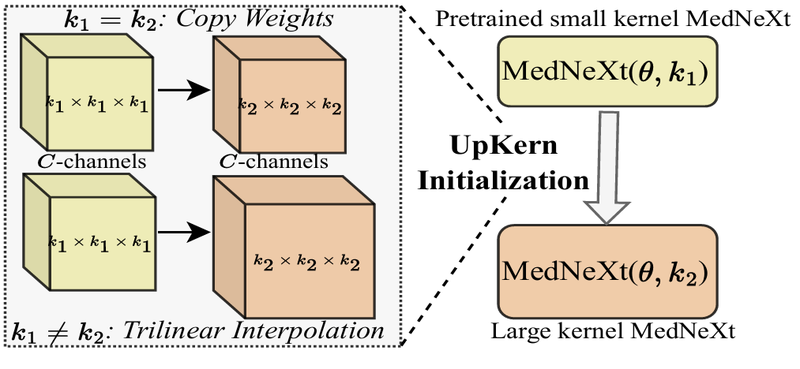

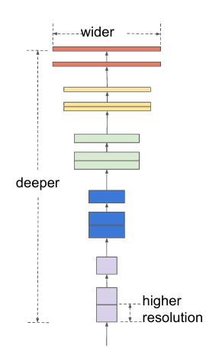

What’s Special about MedNext?...
Compound Scaling of Depth, Width, and Kernel Size: Orthogonal scaling of the number of blocks, number of channels, and receptive field (EfficientNet)
UpKern: Iteratively Increasing Kernel Size by initializing a large kernel network with weights from a trained upsampled small kernel network
https://event.fourwaves.com/spark

Slide 6

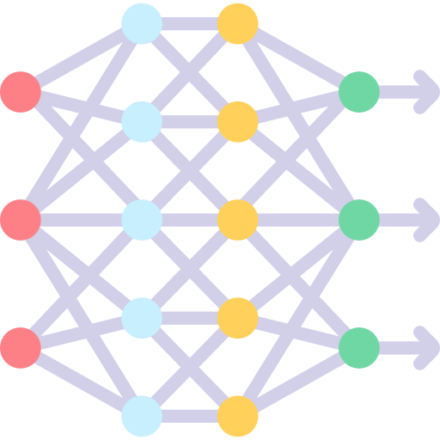

How to use MedNext?...
Use the Up/Down Blocks in your Custom U-Net Implementation
Use the Full Network in your well optimized training loop
(what we are doing)
Train using the Github MedNext Implementation.
(tough due to poor docs)
https://event.fourwaves.com/spark

Slide 7
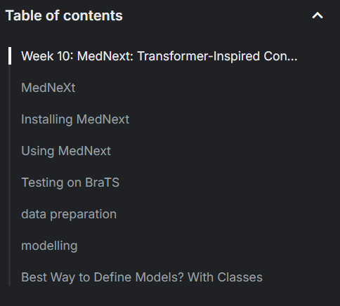
Resources?
MedNext Paper - MedNeXt: Transformer-driven Scaling
MedNext Github - MIC-DKFZ/MedNeXt: [MICCAI 2023]
https://event.fourwaves.com/spark

Slide 8
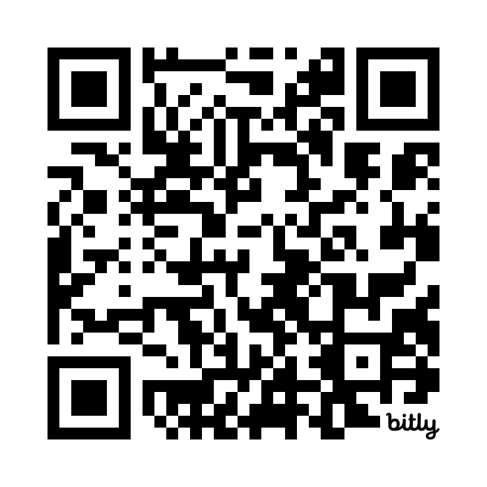
Get in touch?
Email
toufiqmusah32@gmail.com
Web
bit.ly/toufiqmusah

Slide 9
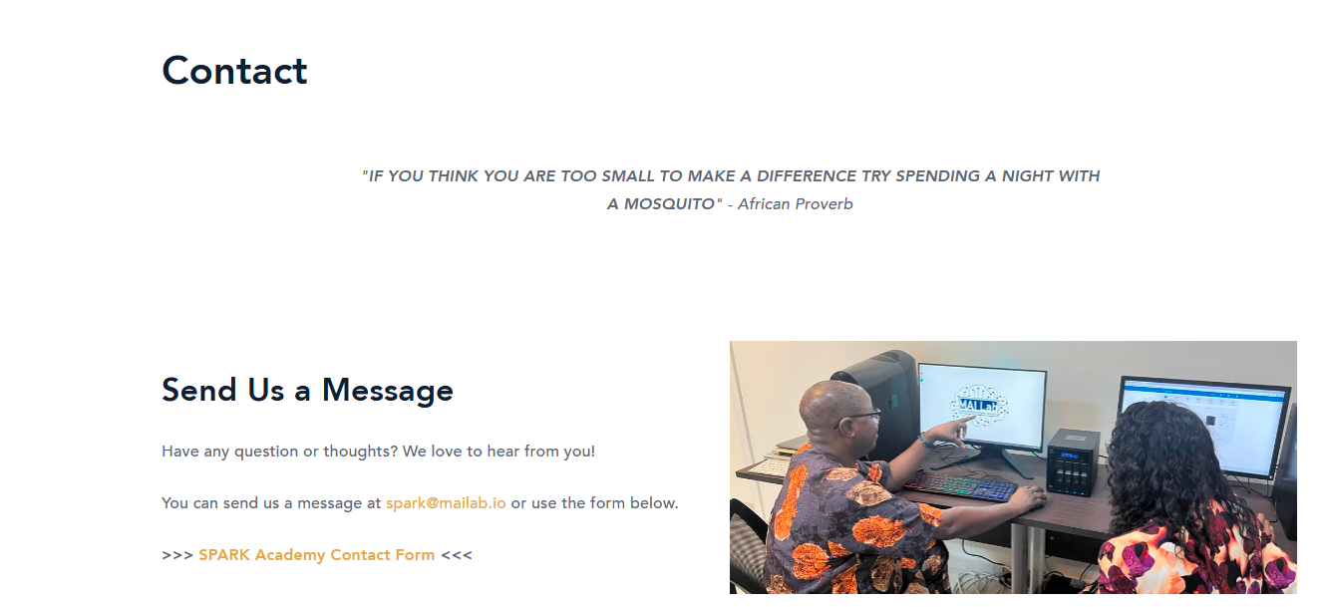
FAQ and Contact Information
Contact
For general program information, consult the FAQ section of the training platform in Fourwaves.
For general program inquiry, contact the SPARK Academy team at spark@mailab.io.
For project specific information or questions related to your team assignment, hackathon project or team’s BraTS project, contact your Team Supervisor.
For all other program related inquiries, contact the SPARK Academy team at spark@mailab.io
Socials: Follow us for up-to-date program information
https://twitter.com/CAMERAAfrica
https://twitter.com/mailab_io
https://www.linkedin.com/company/consortium-for-advancement-of-mri-education-research-in-africa
https://event.fourwaves.com/spark

